Slide 1
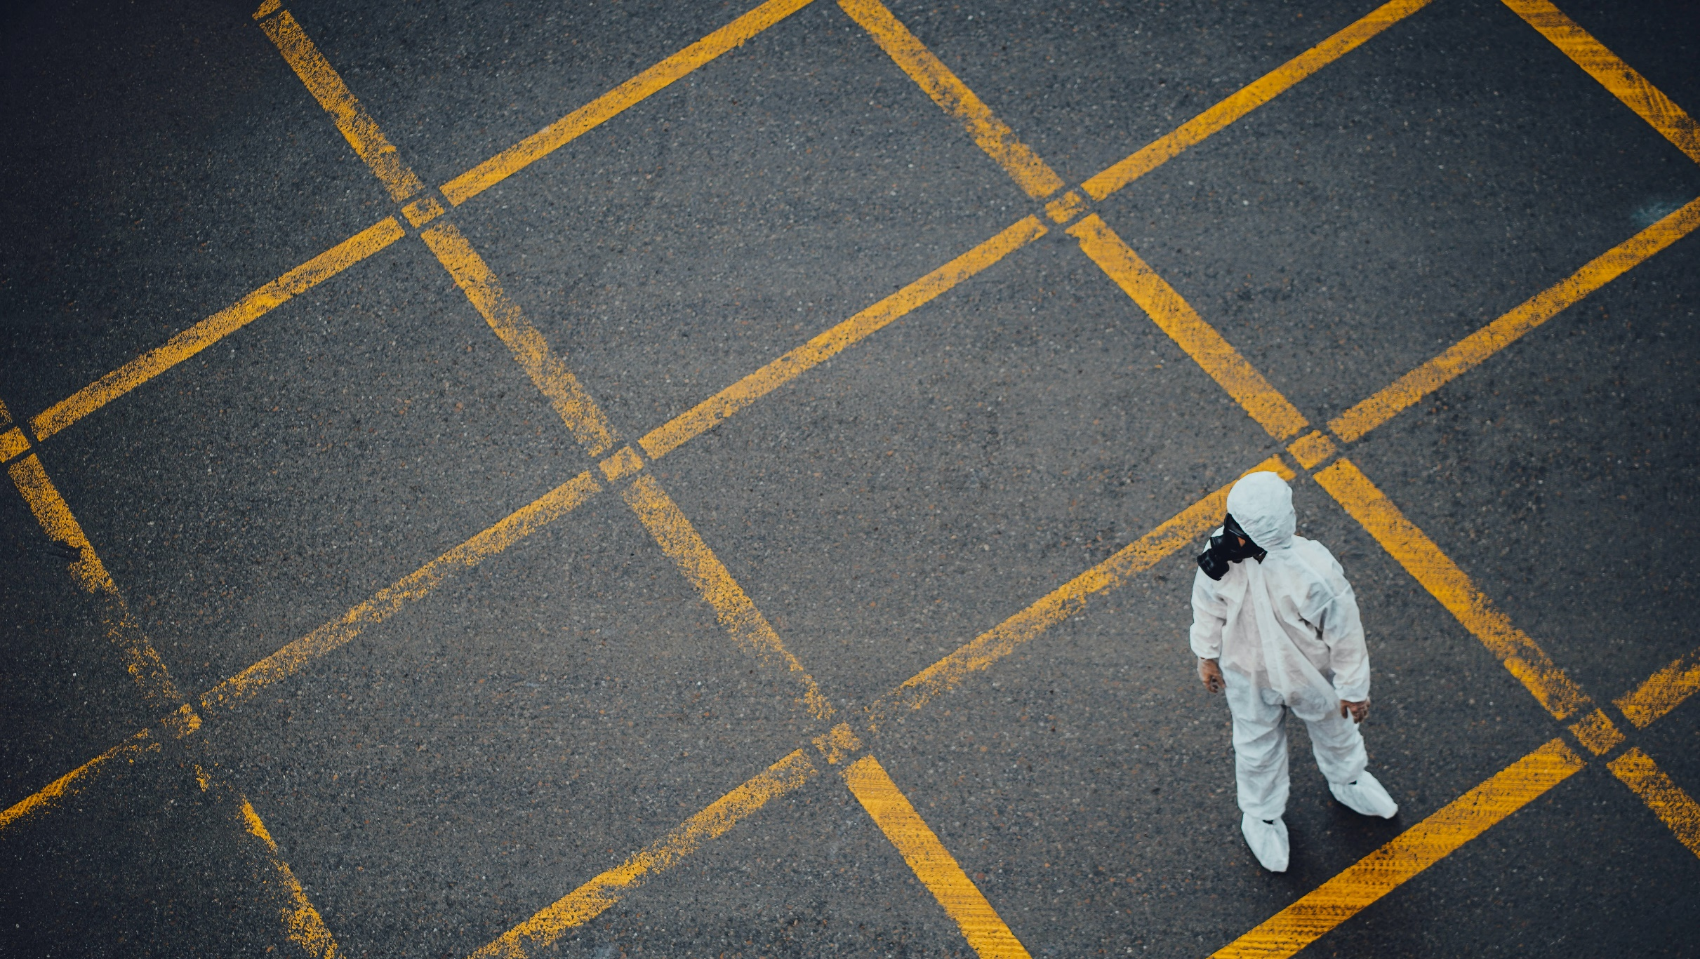
Problems of
the epidemics in art
By students of Ivan Franko National University of Lviv

Slide 2
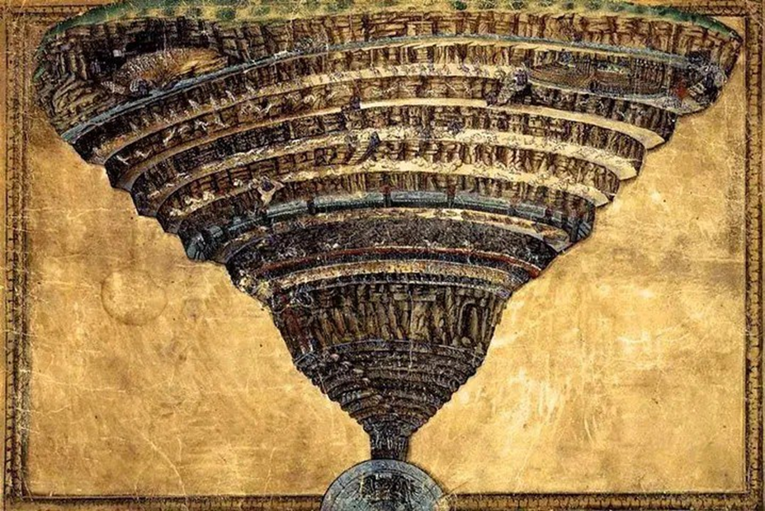
“ Inferno ” Dan Brown –
the epidemic of overpopulation
By Yuliia Apetyk & Yevheniia Kosana
The title - Inferno - from Dante's poem “Divine Comedy”.
“Inferno” is the Italian word for ‘Hell’.

Slide 3
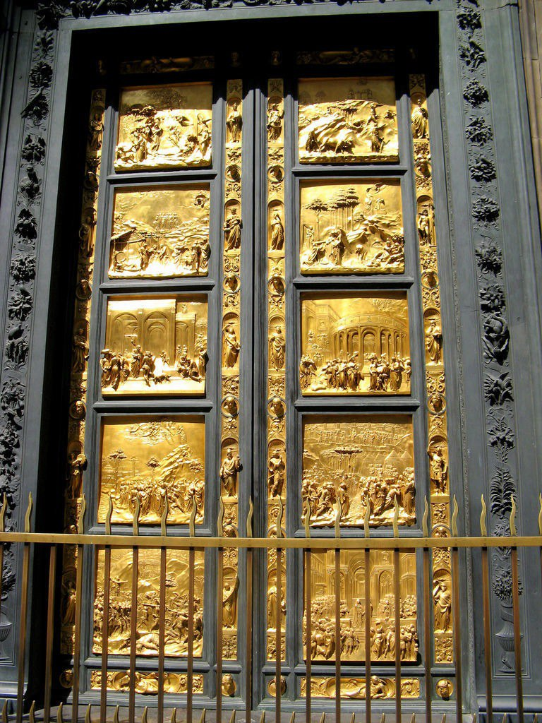
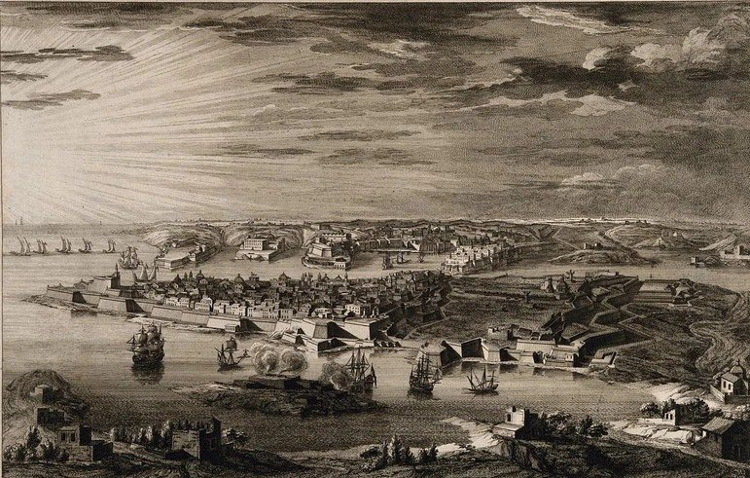
“
Ask yourself, What followed the Black Death? We all know the answer. The Renaissance. Rebirth. It has always been this way. Death is followed by birth. To reach Paradise, man must pass through Inferno
“
The Gates of Paradise
by Lorenzo Ghiberti
The origin of the word ‘quarantine’.

Slide 4
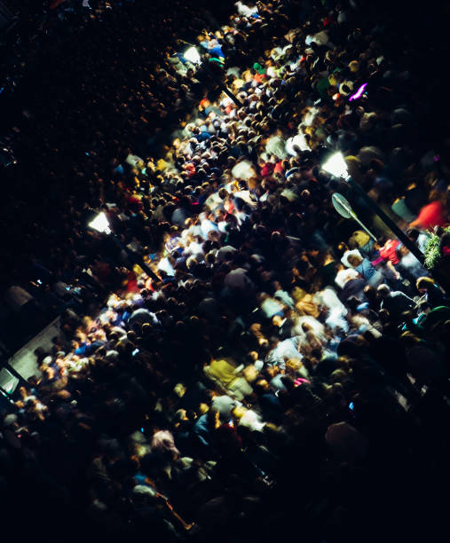
“Mankind, if unchecked, functions like cancer"
The author wants us to think about it, and even says that we should not stay silent and deal with the problem of overpopulation:
"In dangerous times, there is no greater sin than inaction."

Slide 5
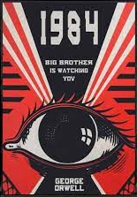
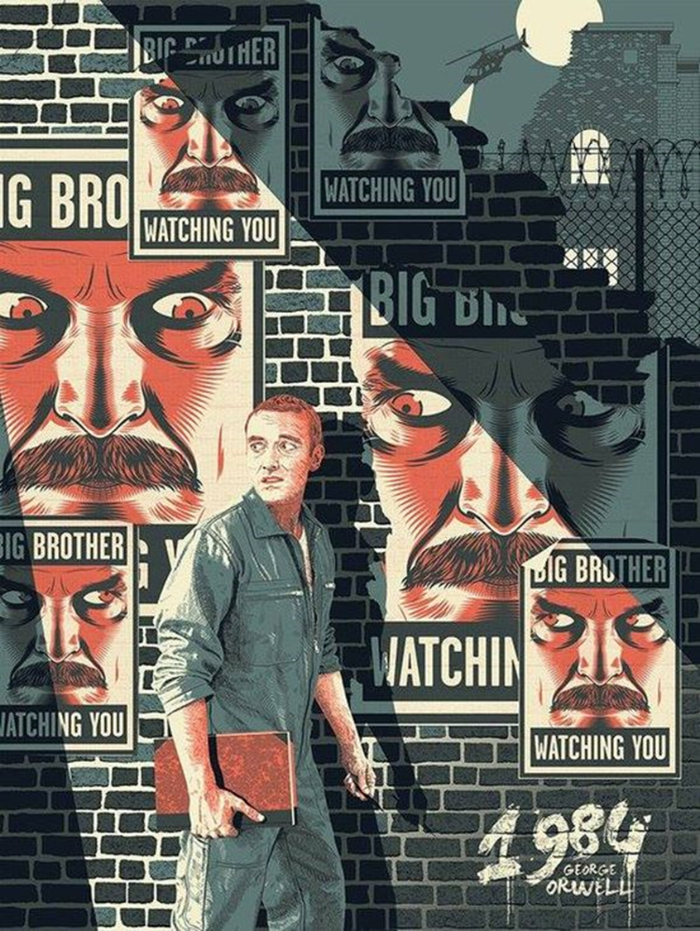
1984 by George Orwell as
an example of social epidemics
By Mariia Tatsynets & Mariia Anna Kudla
The epidemic illustrated in “1984” is not related to the physical (disease), but more to the mental world of people.

Slide 6
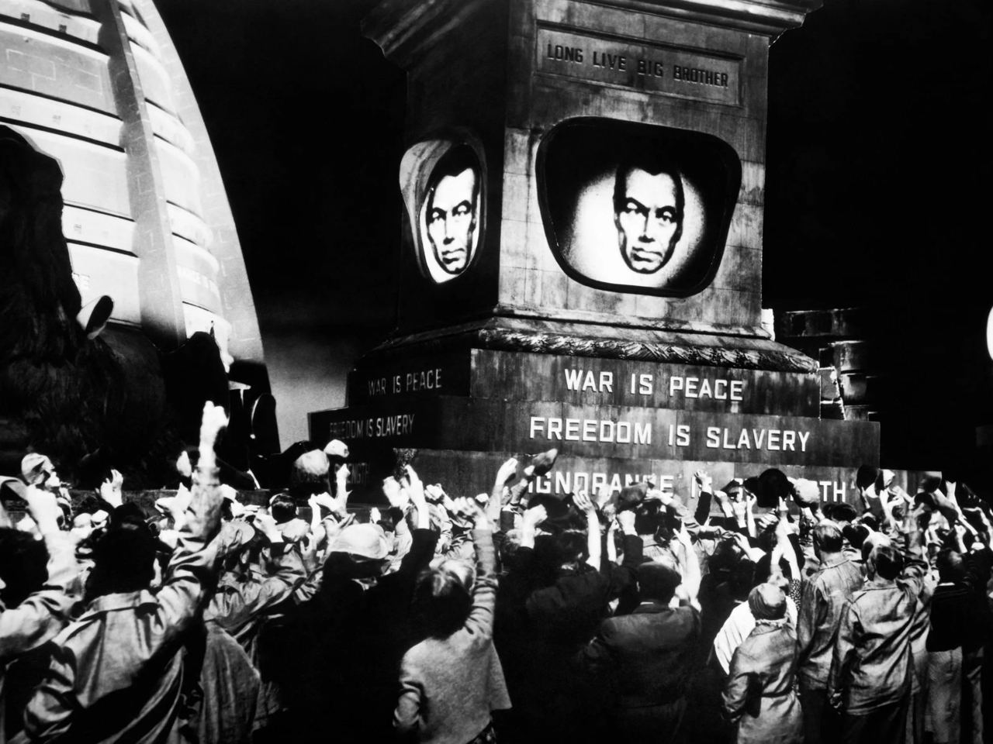
Big Brother as a symbol

Slide 7
«The Fifth Wave»
Social epidemics can be also connected with the regular ones. We would like to present as an example movie «The fifth wave».

Slide 8
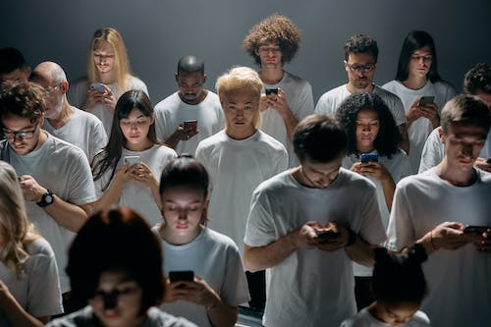
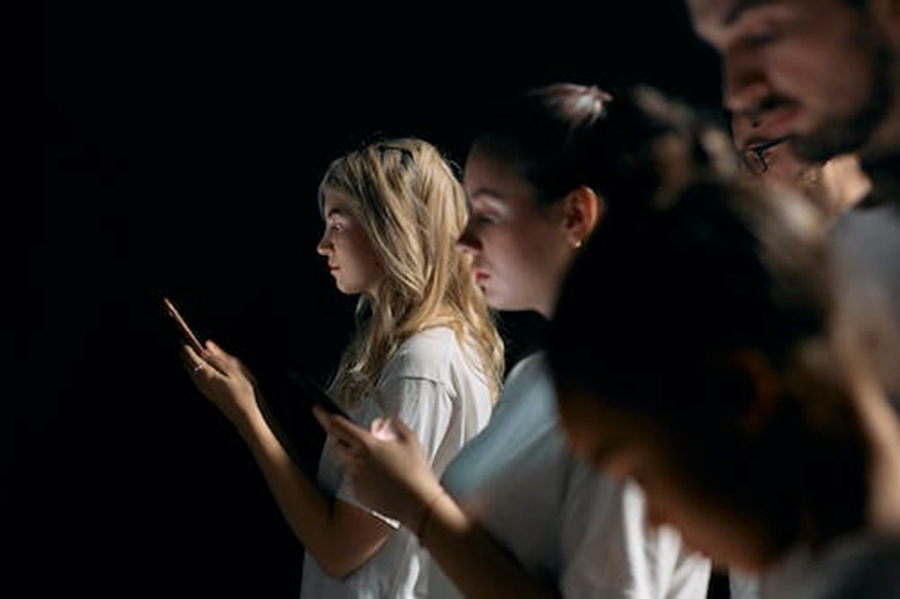
The epidemic of addiction
By Mariia Bojkiv
The World Health Organization regularly updates the list of addictions with new items. The most common are drug, alcohol, gaming, religious, and food ones.

Slide 9
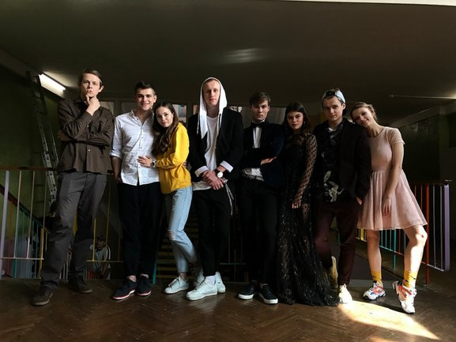
In the course of events becomes known that each «investigator» has a skeleton in the cupboard.

Slide 10
There are more sources to seek help, such as free hotlines, anonymous crisis text lines, addiction recovery clinics, and many others.

Slide 11
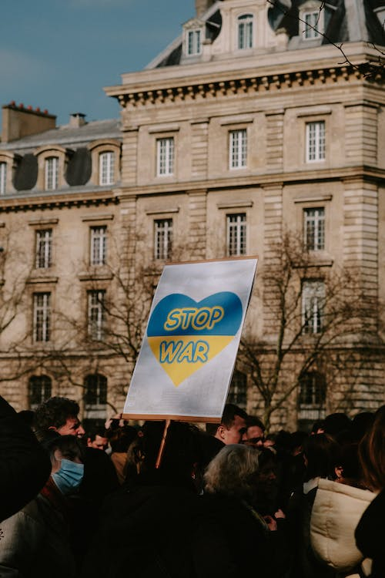
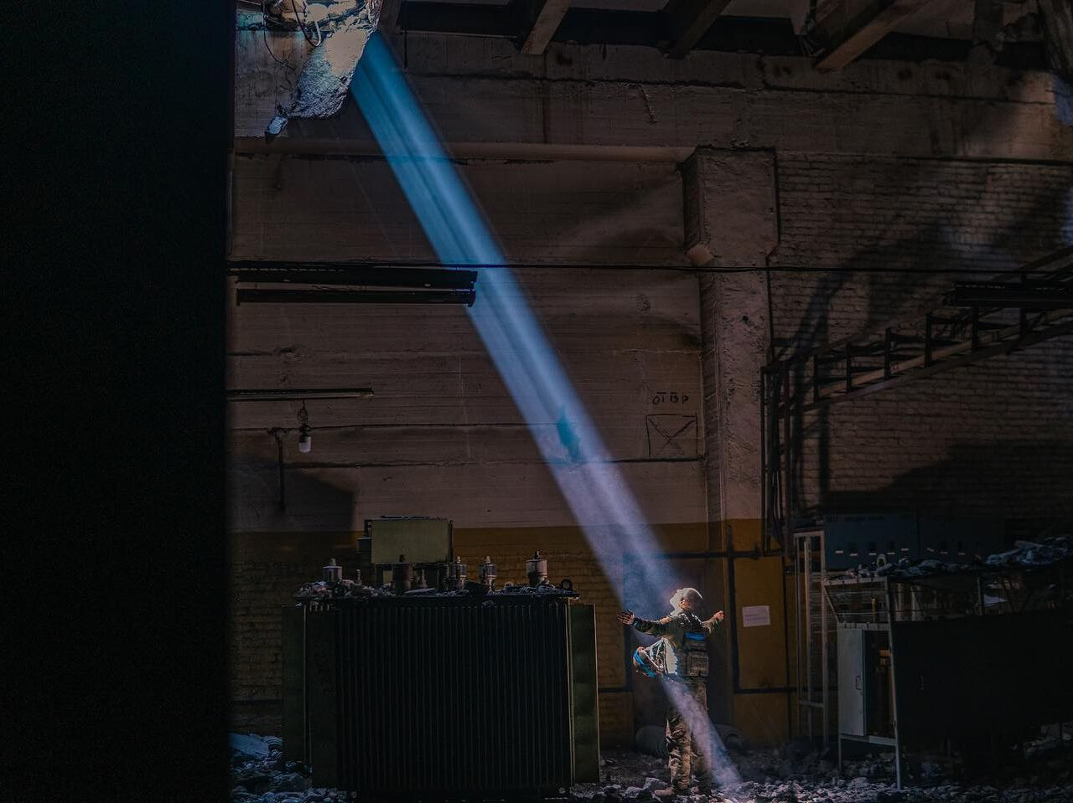
Russo - Ukrainian War
-Regular epidemics
-Social epidemics (fear, ZOMBIFICATION)

Slide 12
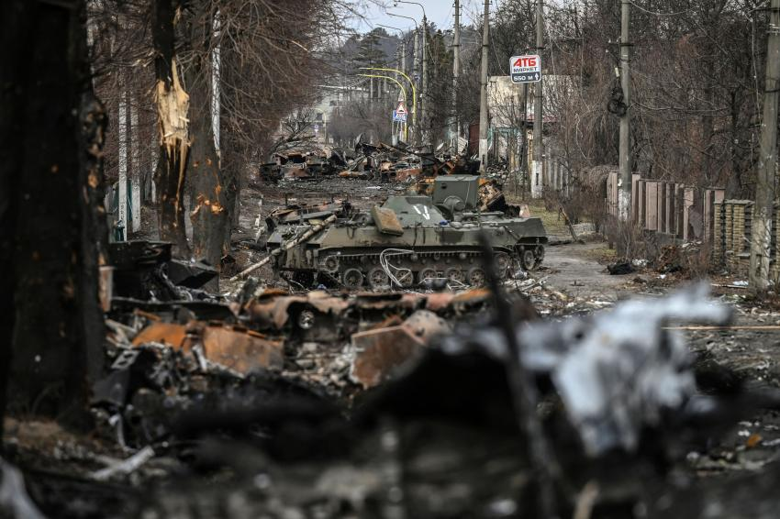
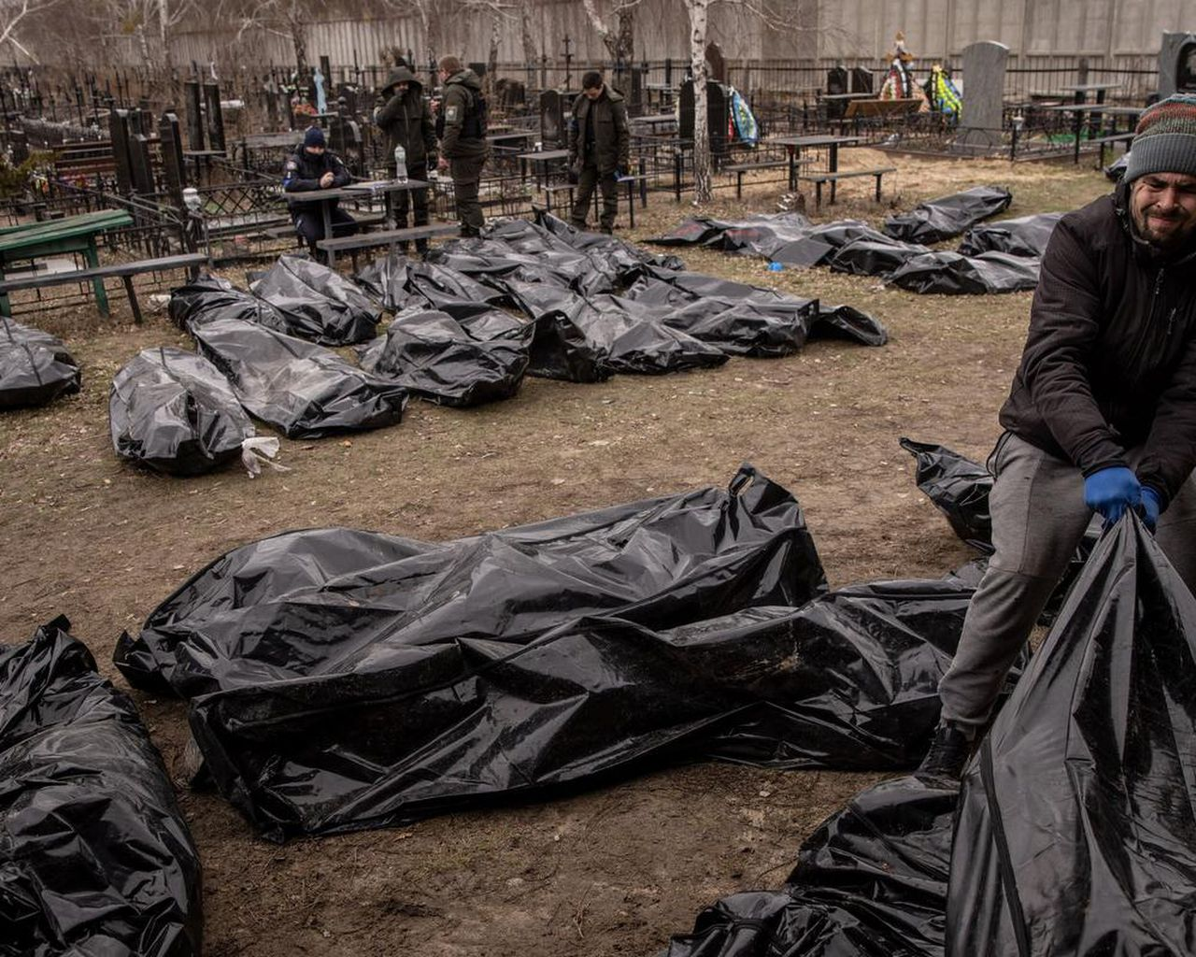
russian’s cruelty

Slide 13
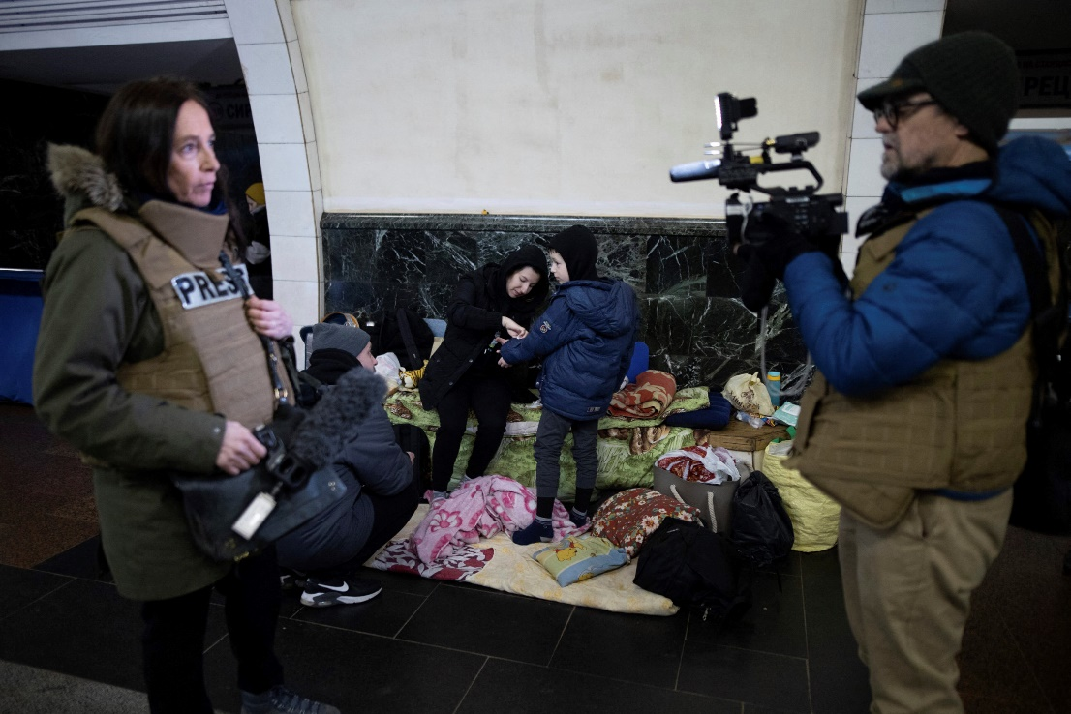
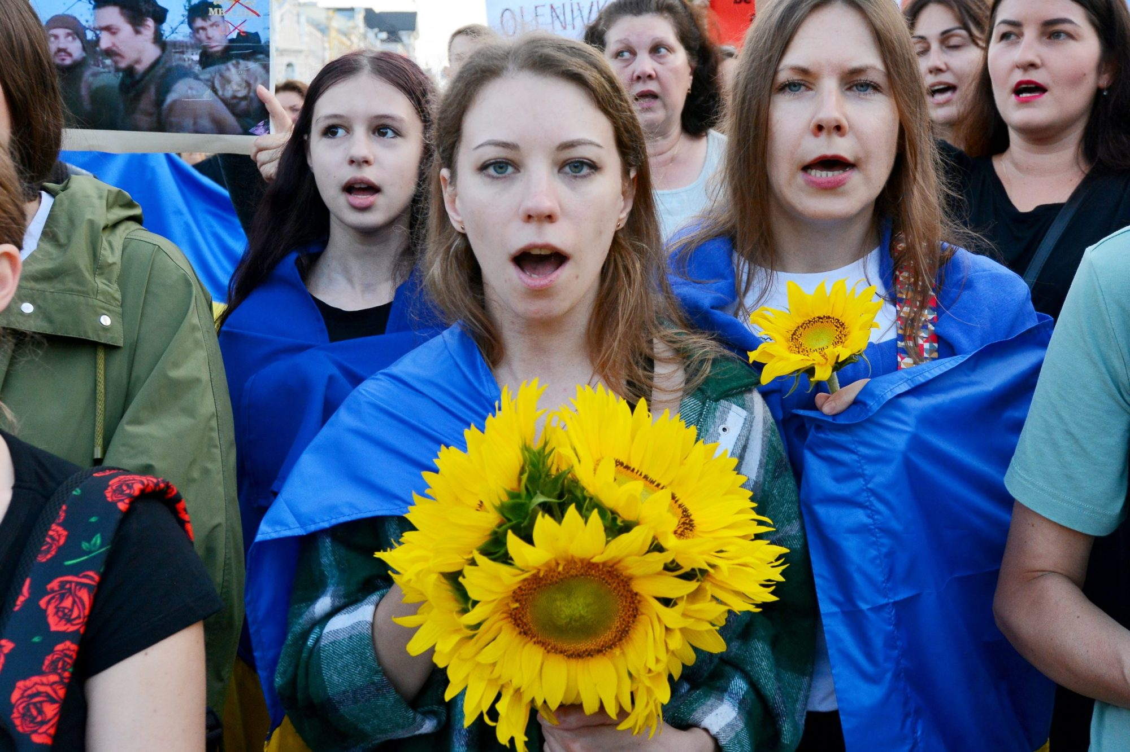
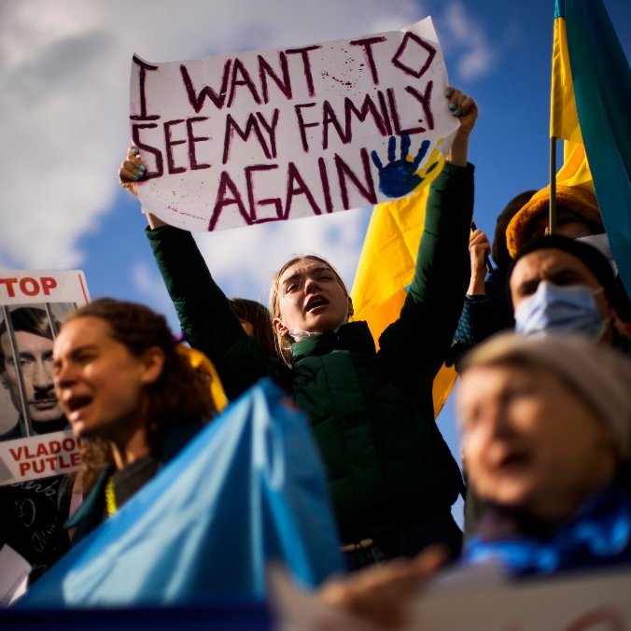
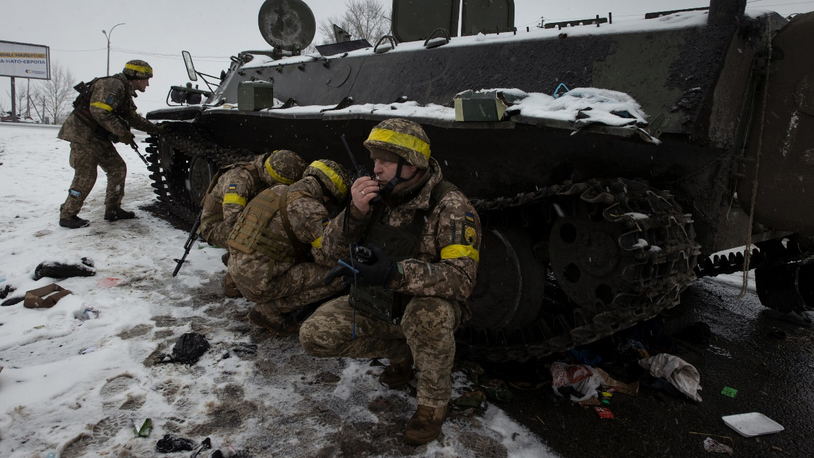

Slide 14
Importance of being communication among young generation

Slide 15
Thank you for your attention

