Slide 1
The Chornobyl disaster through the prism of postmodernist literature and cinema
Presented by Kateryna Shvorob, Vladyslava Ivankiv

Slide 2
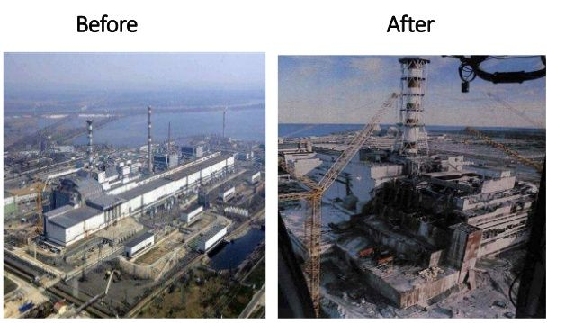
The 1986 Chornobyl disaster
The Chornobyl accident resulted in the largest uncontrolled release of radioactive materials ever recorded in civilian operations, lasting about 10 days. This event had severe social and economic consequences for populations in Ukraine and the USSR at the time.
The Chornobyl accident on April 26, 1986, resulted from a flawed reactor design and inadequate operator training, disabling shutdown mechanisms, causing a power surge, and leading to a series of explosions.
After the Chornobyl accident, the priority was to clean up the site for the potential restart of the remaining three reactors and to provide more permanent shielding for the damaged reactor. Soviet authorities initially concealed information about the accident, organized public demonstrations despite rising radiation levels, and only acknowledged the disaster 36 hours later.
1

Slide 3
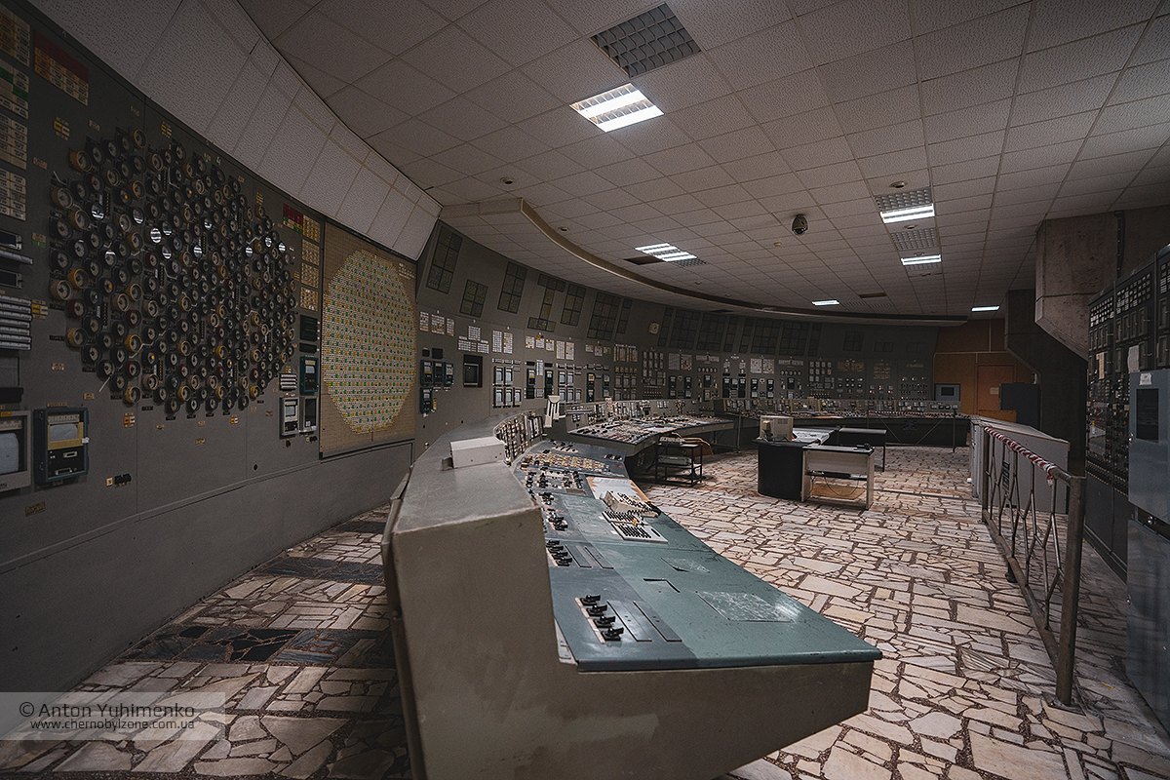
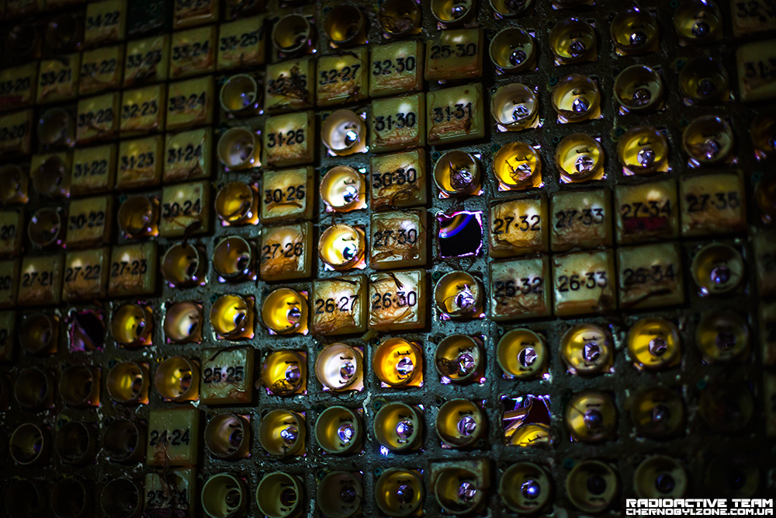
The 1986 Chornobyl disaster
The aftermath of the disaster involved extensive cleanup efforts by over 600,000 individuals, including firefighters and military personnel who faced health risks. The New Safe Confinement, completed in 2019, aimed to contain the remains of the reactor unit and prevent the release of radioactive contaminants. The Chornobyl Radiation-Ecological Biosphere Reserve, established in 2016, restored local flora and fauna and serves as a sanctuary for rare Ukrainian species.
Despite the ongoing impact of the Chornobyl tragedy for hundreds of years, efforts have been made to mitigate its consequences. russia's invasion of Ukraine in 2022, has posed new threats. russian forces temporarily occupied the Chornobyl Nuclear Power Plant, causing an increase in radiation levels, destroying laboratories, and sparking fires. Ukrainian counter-offensive efforts in March 2022 expelled the russian forces, but ongoing dangers persist, with Russia still occupying the Zaporizhzhia Nuclear Power Plant
1

Slide 4
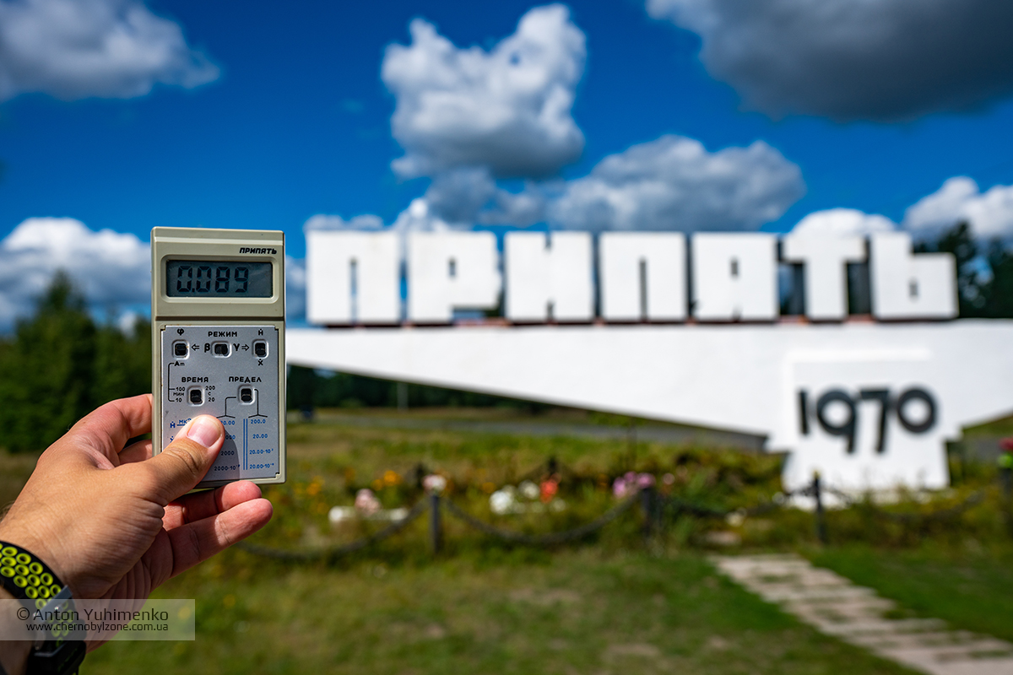
The world’s reaction to Chornobyl disaster
Due to Chernobyl, some governments opted to discontinue existing nuclear energy programs, while others abandoned plans for new ones.
After the Chernobyl disaster, the United States, along with other nations and international organizations, assisted in constructing a protective concrete shelter, known as the sarcophagus, to contain the damaged reactor and prevent further contamination.
Since the explosion, Pripyat has remained uninhabitable, with deteriorating buildings reflecting the aftermath. A few individuals have returned, but it's rare. Recently opened to tourists, the town has seen wildlife thrive in the absence of human inhabitants over the past four decades.
About 25 years after Chernobyl, the Fukushima Daiichi nuclear accident in Japan prompted a global reassessment by safety regulators. They considered enhancements such as mandating backup generators, as seen in Fukushima, and preparing for unforeseen accident scenarios.
1

Slide 5
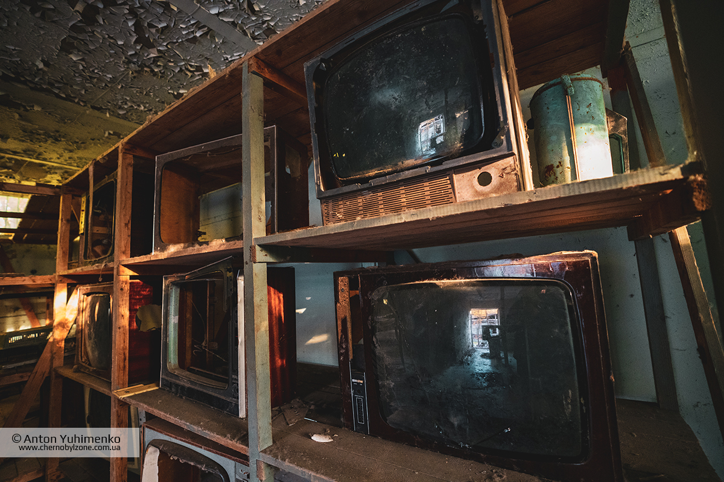
How the Chornobyl disaster impacted the artists throughout the world
Postmodernist artists around the globe responded to the Chornobyl disaster by expressing their creativity in diverse ways, expressing environmental concerns, examining the impact of human activities on the planet and raising awareness about nuclear risks and ecosystem fragility in the wake of the significant environmental catastrophe that was the Chornobyl disaster. Stemming from technological failure, the disaster prompted reflections on the ethical dimensions of scientific advancements and the potential risks associated with unchecked technological progress.
1

Slide 6
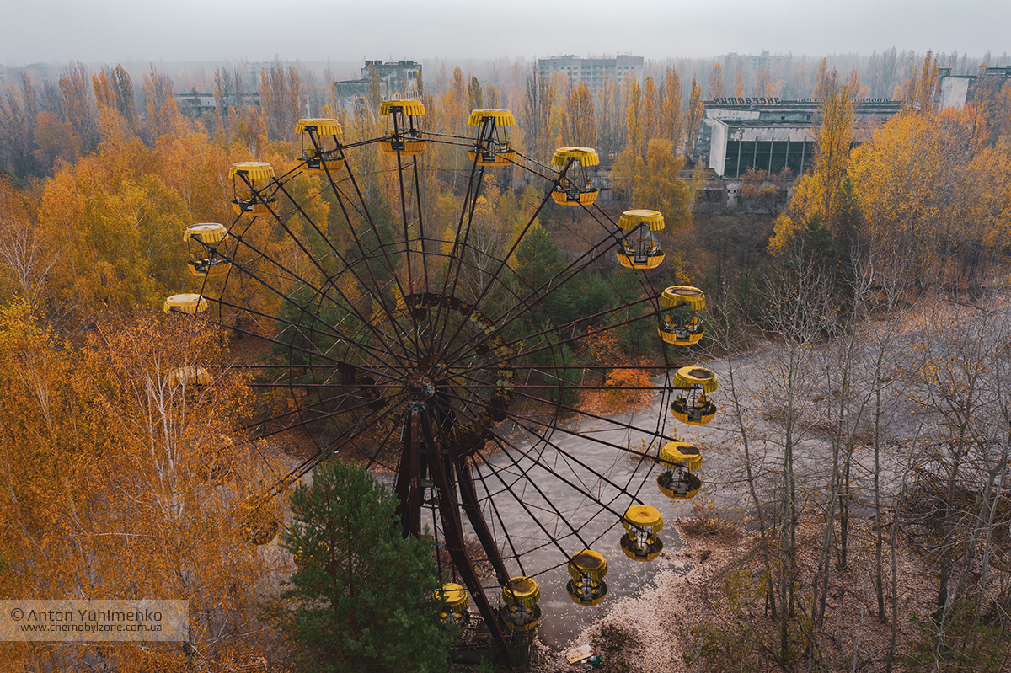
How the Chornobyl disaster impacted the artists throughout the world
Postmodernism's inclination to question traditional power structures found expression in reflections on the Chornobyl disaster, which was linked to the Soviet Union's management and suppression of information. The event became a symbol for artists to contemplate the consequences of authoritarian regimes and the manipulation of truth.
Artists worldwide have actively engaged with its themes, contributing to a broader conversation on the intersection of human activities, technology, and the environment. The disaster remains a historical and cultural touchpoint.
1

Slide 7
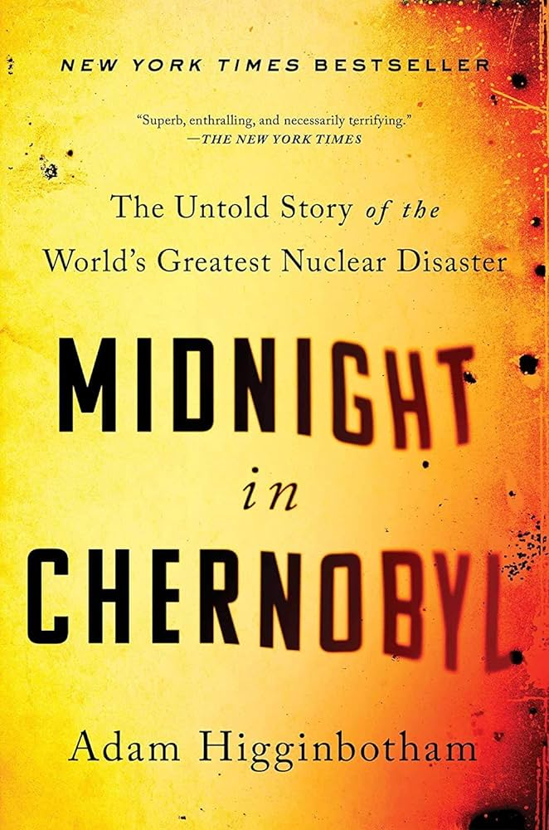
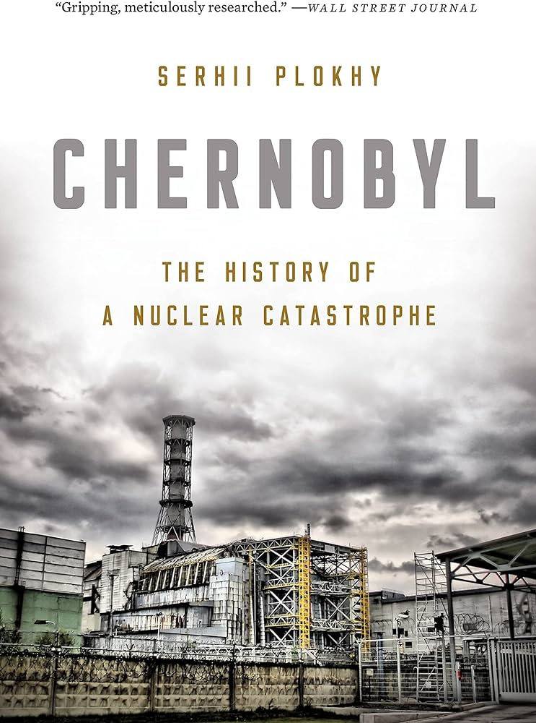
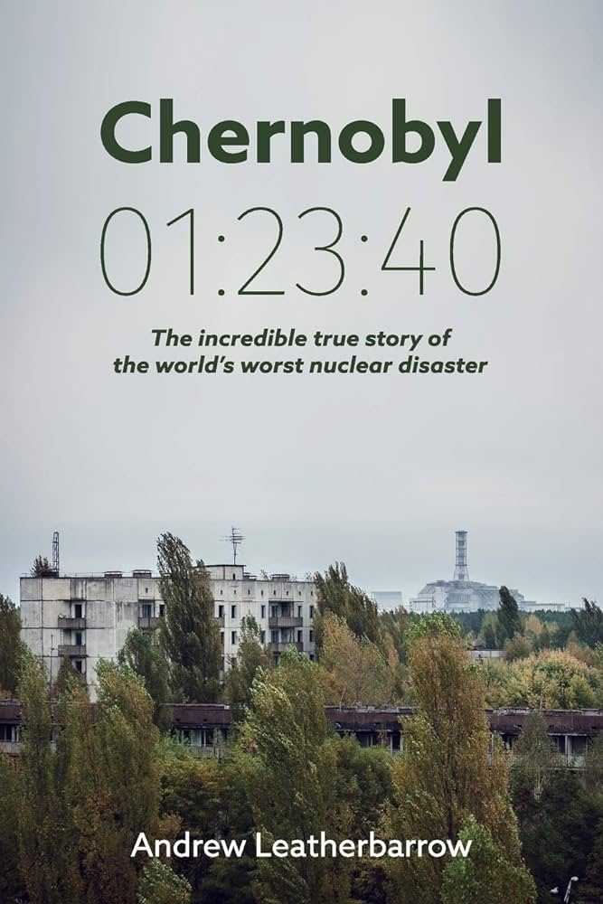
Outstanding pieces of literature impacted by the disaster
Midnight in Chernobyl: The Untold Story of the World's Greatest Nuclear Disaster (2019) by Adam Higginbotham
"Chernobyl: The History of a Nuclear Disaster" by Serhii Plokhy
‘Chernobyl 01:23:40: The Incredible True Story of the World's Worst Nuclear Disaster’ by Andrew Leatherbarrow
1

Slide 8
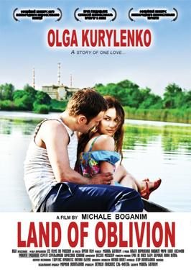
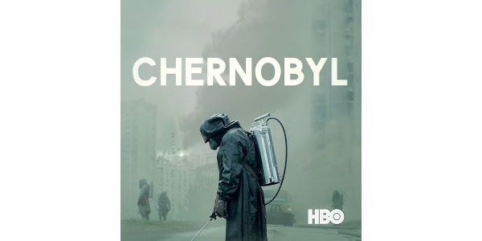
Postmodernist cinematographic view on the catastrophe
"Land of Oblivion" (original title: "La Terre Outragée") is a French-language drama film directed by Michale Boganim. The film was released in 2011
"Chernobyl" is a television miniseries that premiered in 2019. It is a historical drama created by Craig Mazin and directed by Johan Renck
1

Slide 9
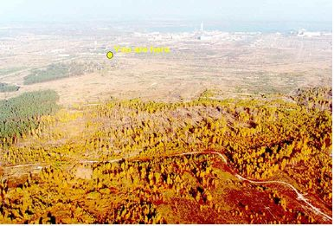
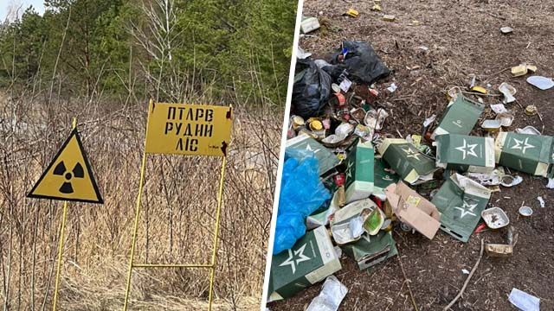
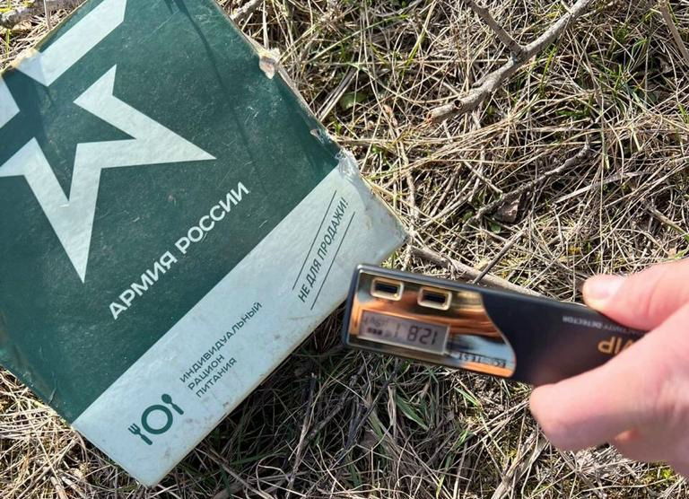
Ongoing consequences of the disaster
1

Slide 10
Thank you for your attention!

